Slide 1
Object Oriented Programming
Course Instructure: Engr. Samina Bilquees
saminabilquees1996@gmail.com

Slide 2
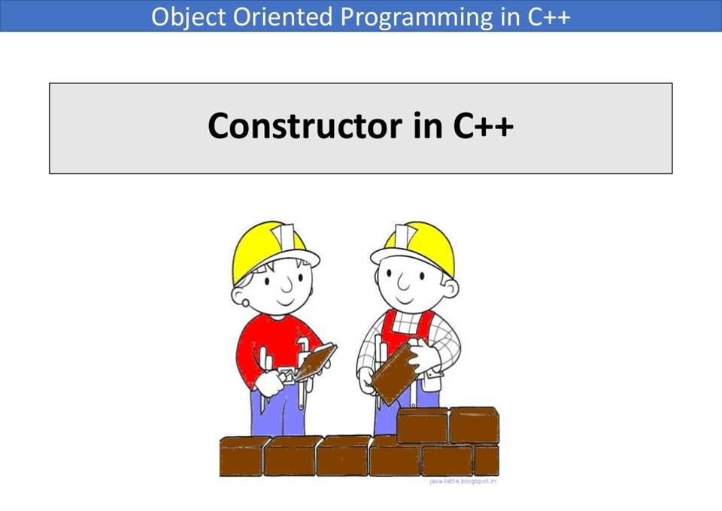

Slide 3
Constructor
We see that member functions can be used to give values to the data items in an object.
Sometimes, however, it’s convenient if an object can initialize itself when it’s first created, without requiring a separate call to a member function.
Automatic initialization is carried out using a special member function called a constructor.
A constructor is a member function that is executed automatically whenever an object is created.

Slide 4
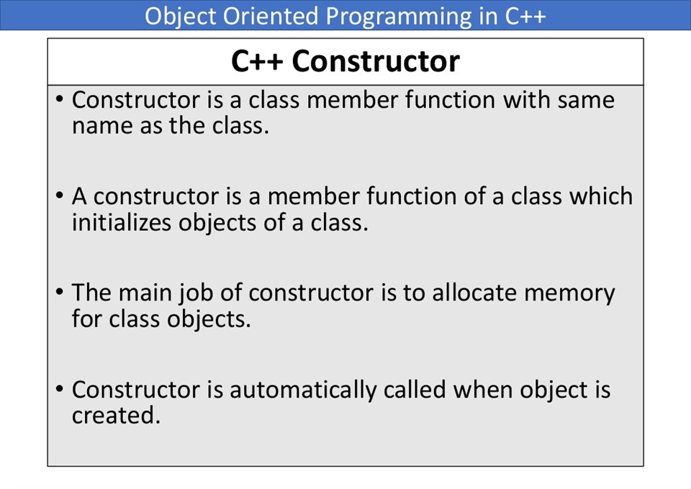

Slide 5
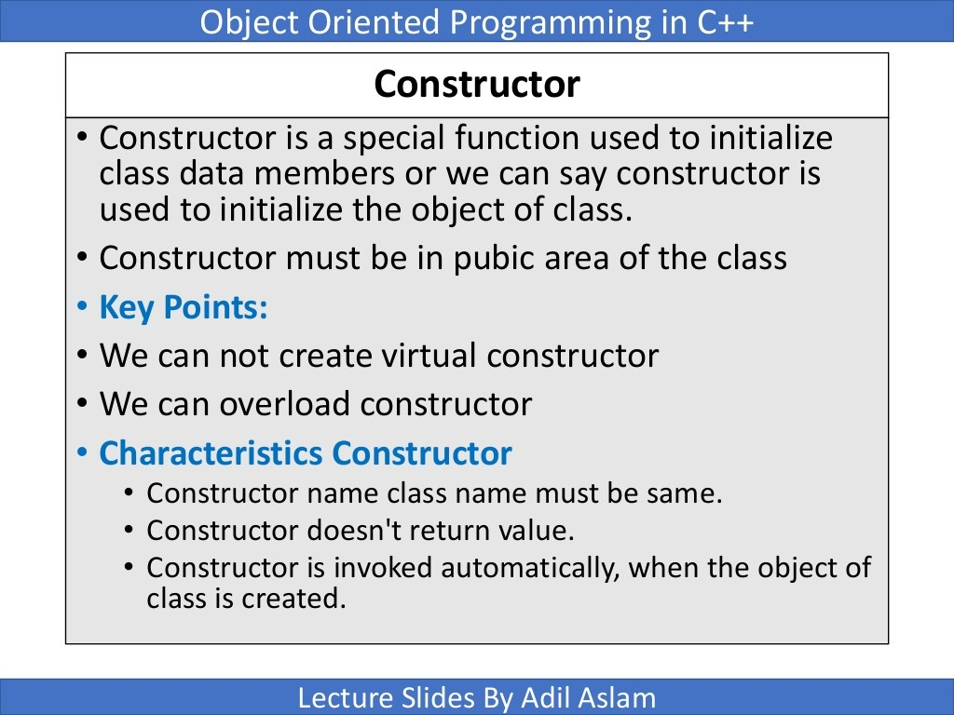

Slide 6
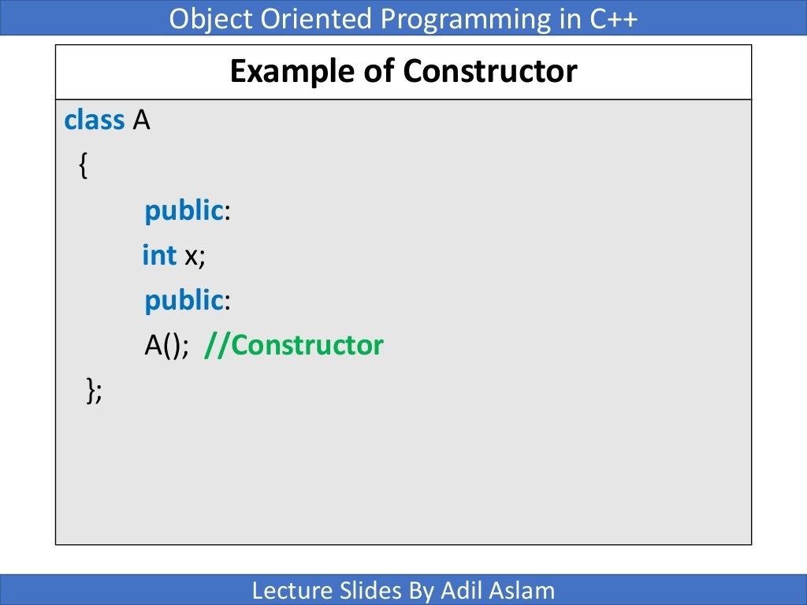

Slide 7
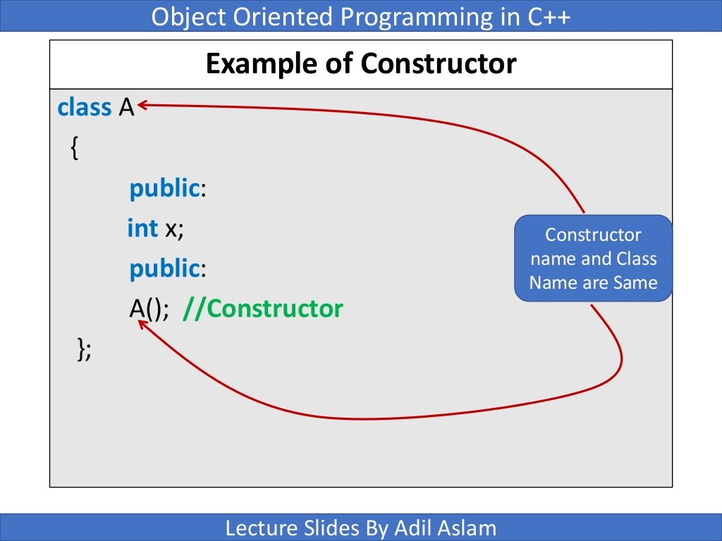

Slide 8
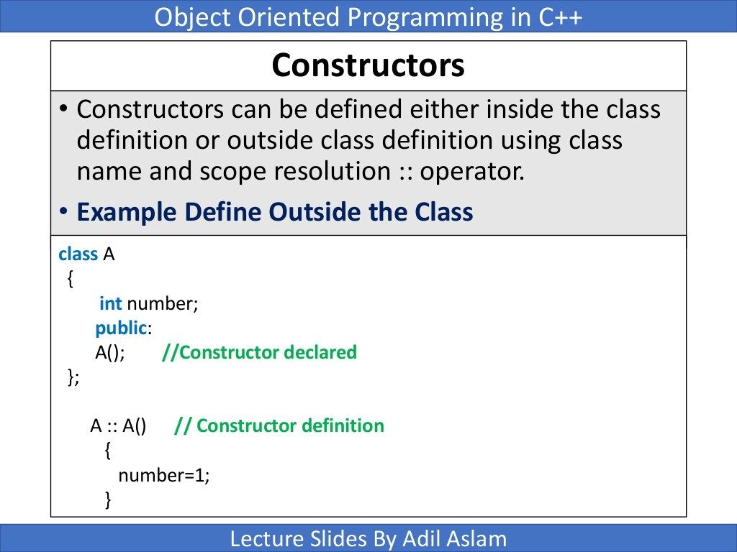

Slide 9
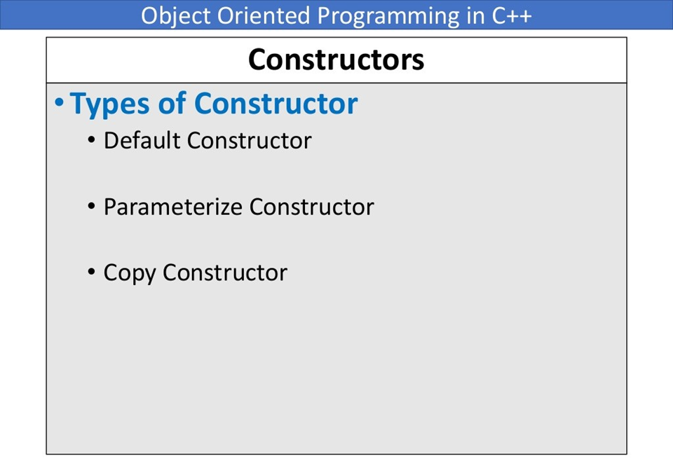

Slide 10
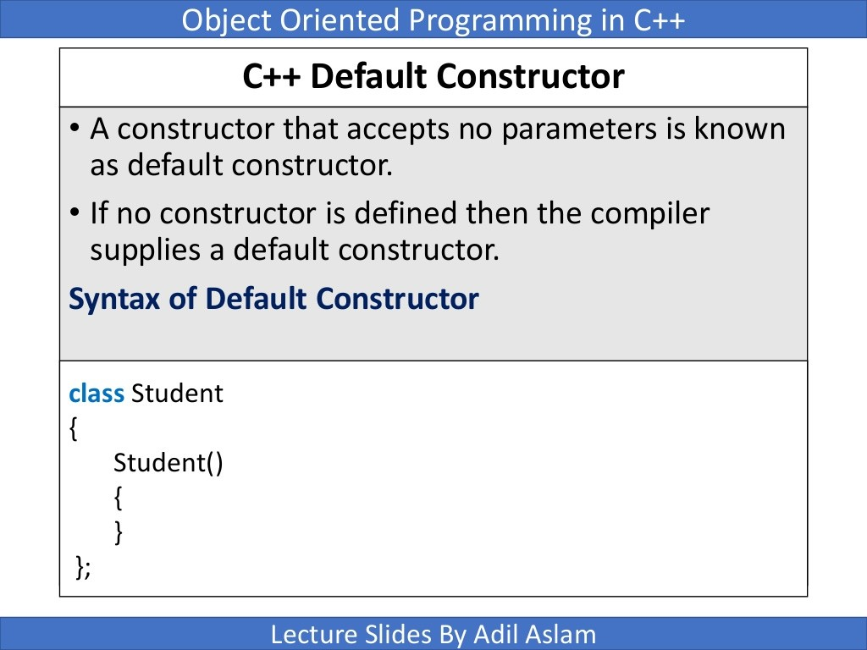

Slide 11
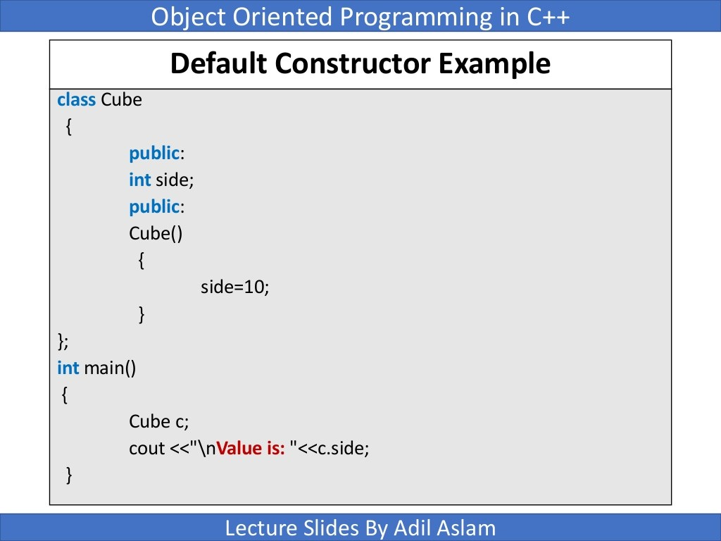

Slide 12
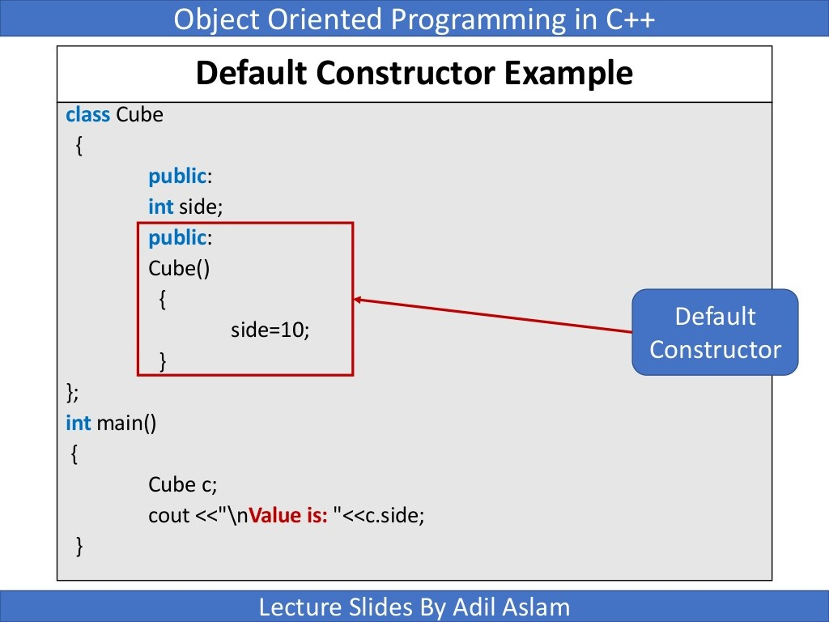

Slide 13
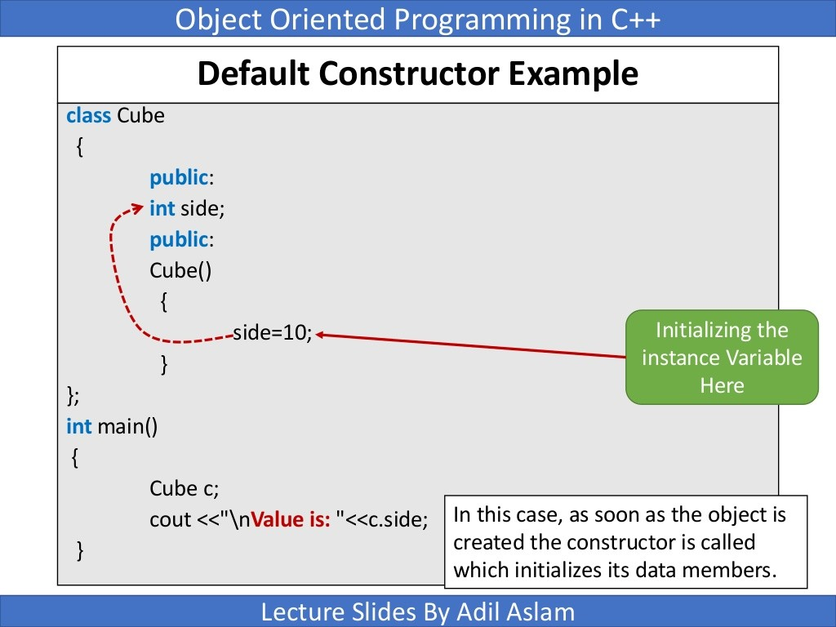

Slide 14
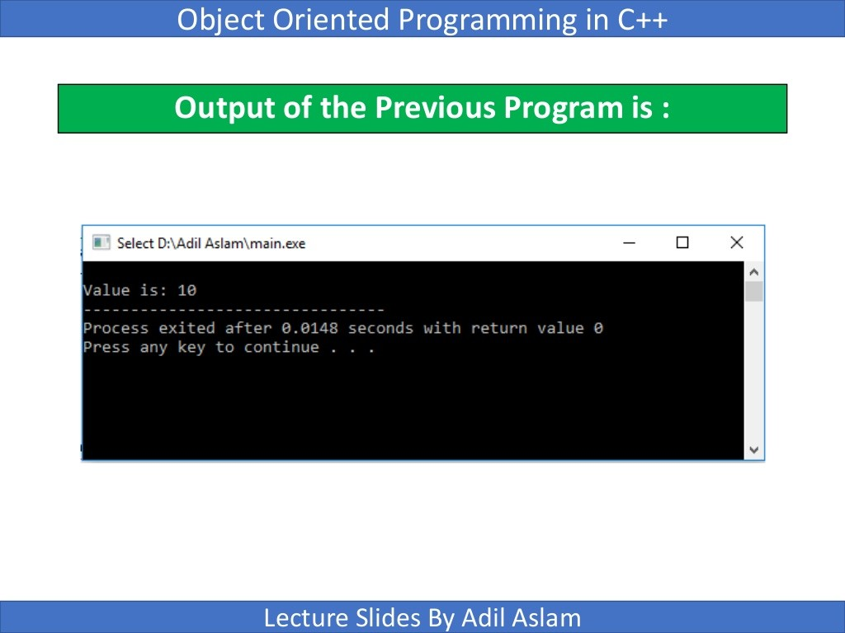

Slide 15
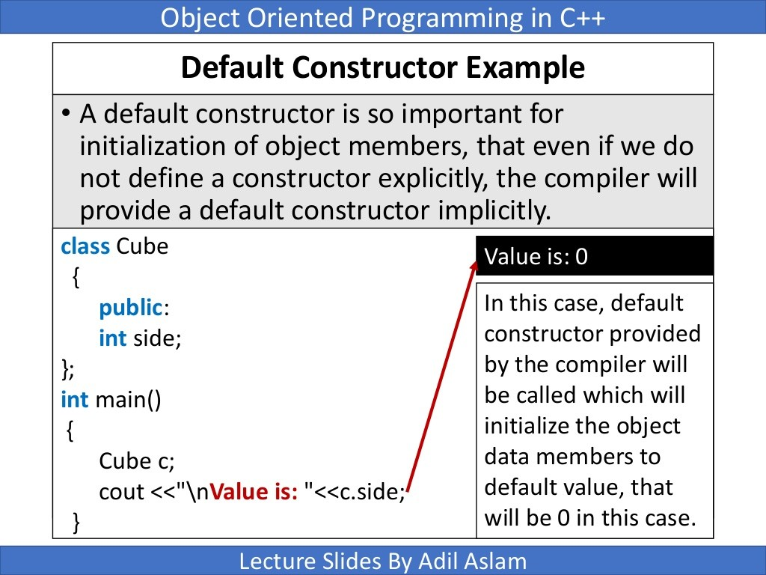

Slide 16
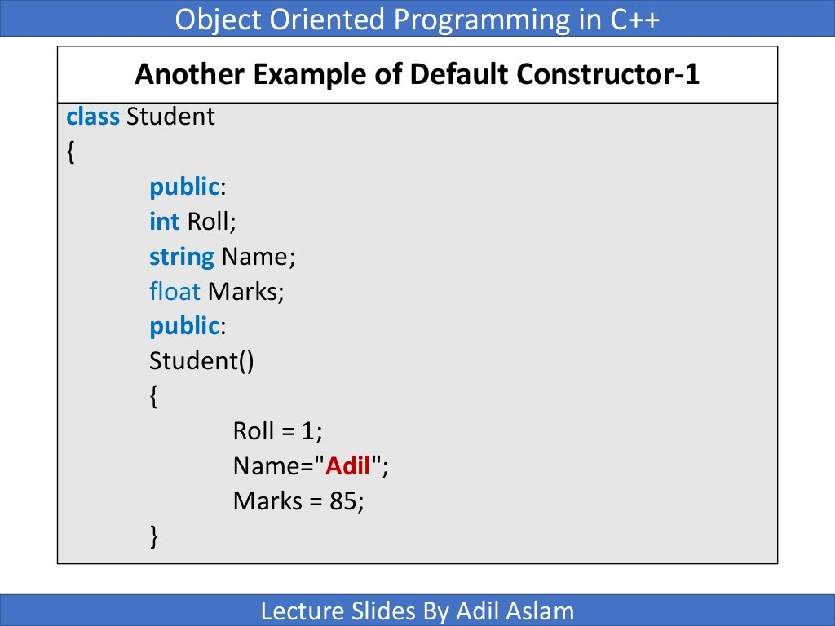

Slide 17
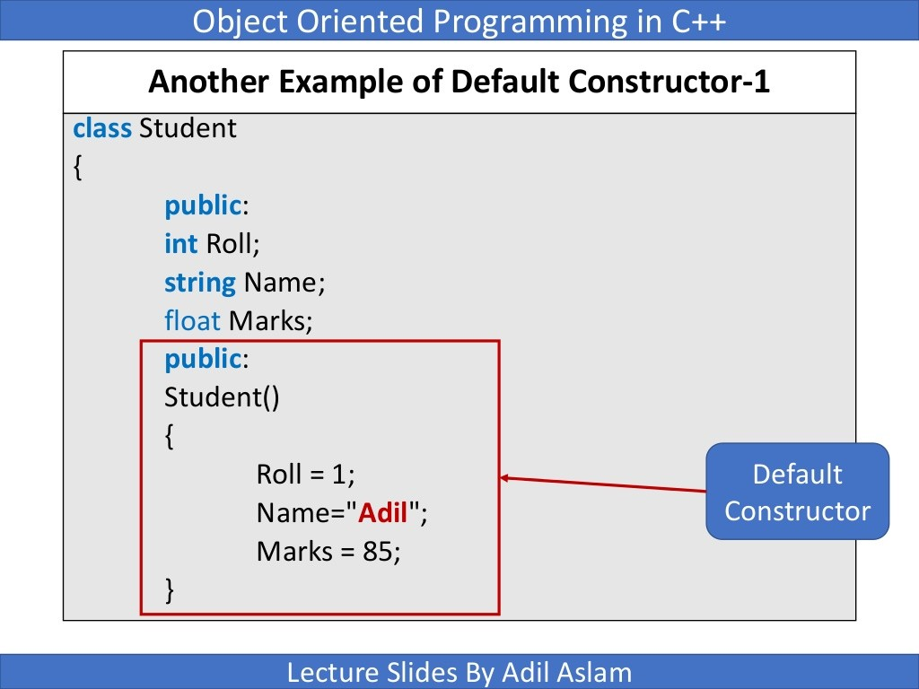

Slide 18
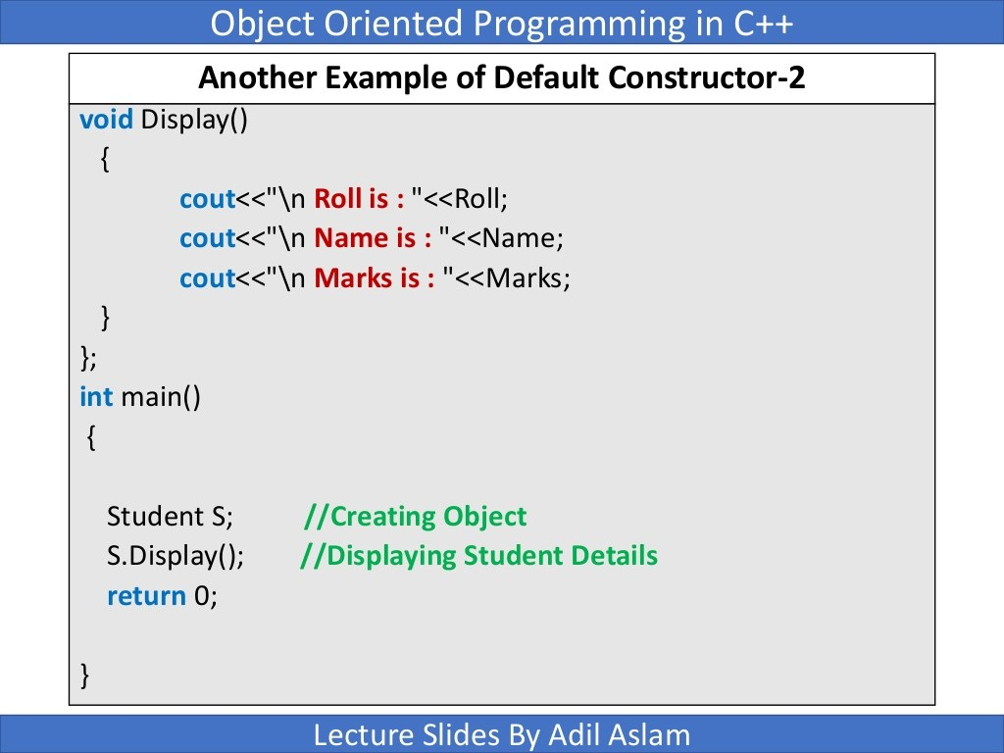

Slide 19
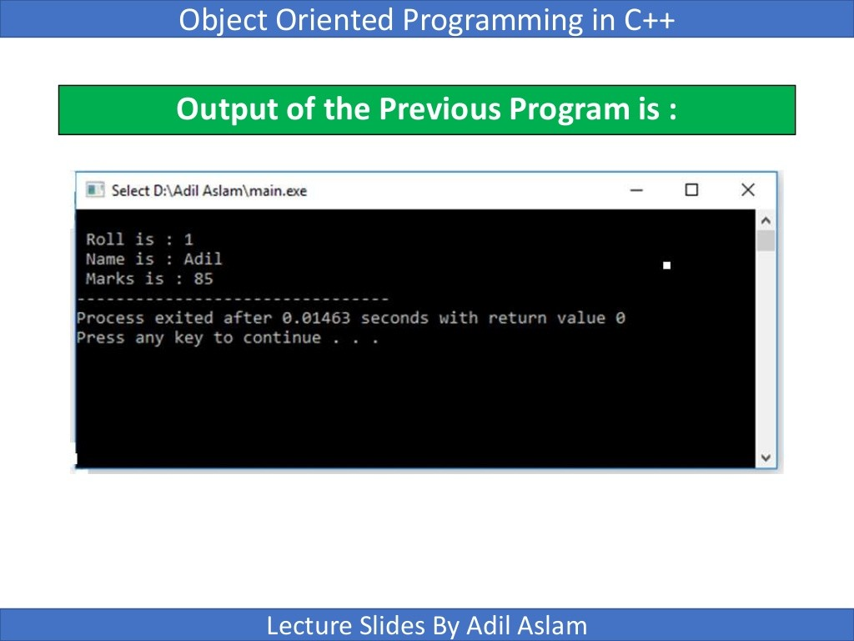

Slide 20
Counter Example
As an example, A counter is a variable that counts things. Maybe it counts file accesses, or the number of times the user presses the Enter key, or the number of customers entering a bank. Each time such an event takes place, the counter is incremented (1 is added to it). The counter can also be accessed to find the current count.

Slide 21
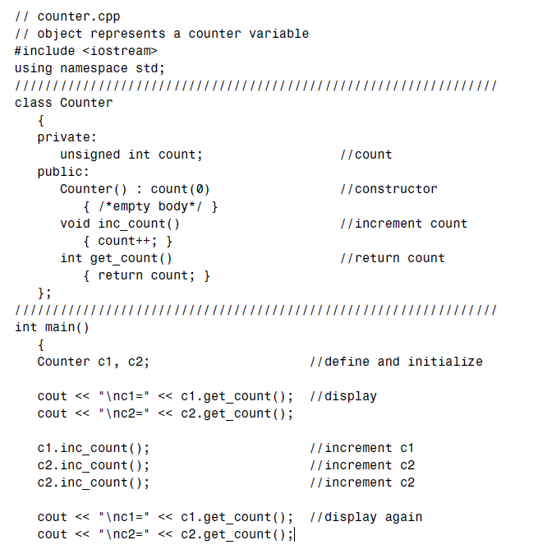

The Counter class has one data member: count, of type unsigned int (since the count is always positive).
It has three member functions:
the constructor Counter(), which we’ll look at in a moment;
inc_count(), which adds 1 to count;
and get_count(), which returns the current value of count.

Slide 22
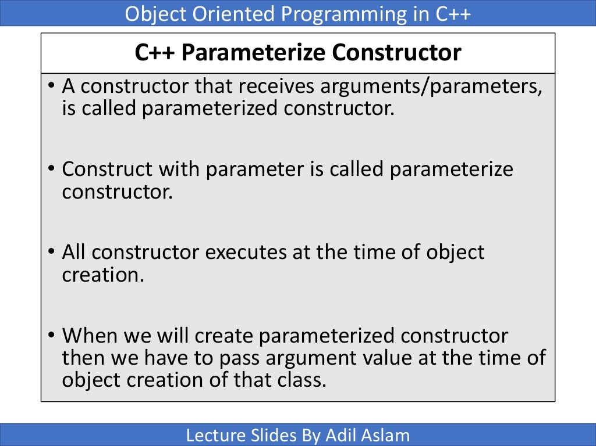

Slide 23
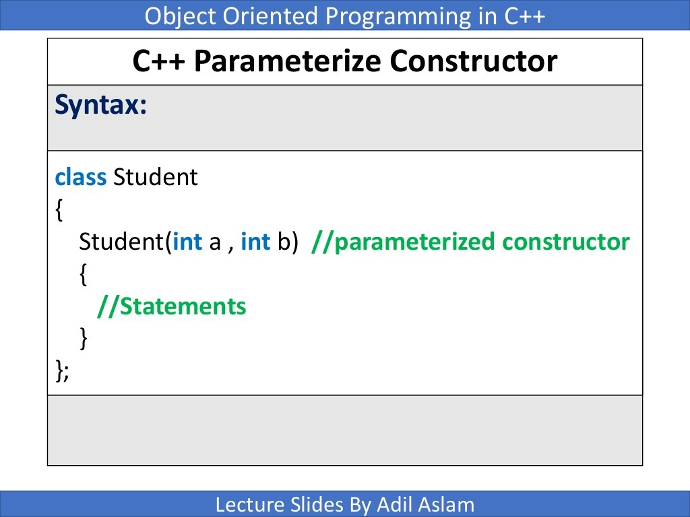

Slide 24
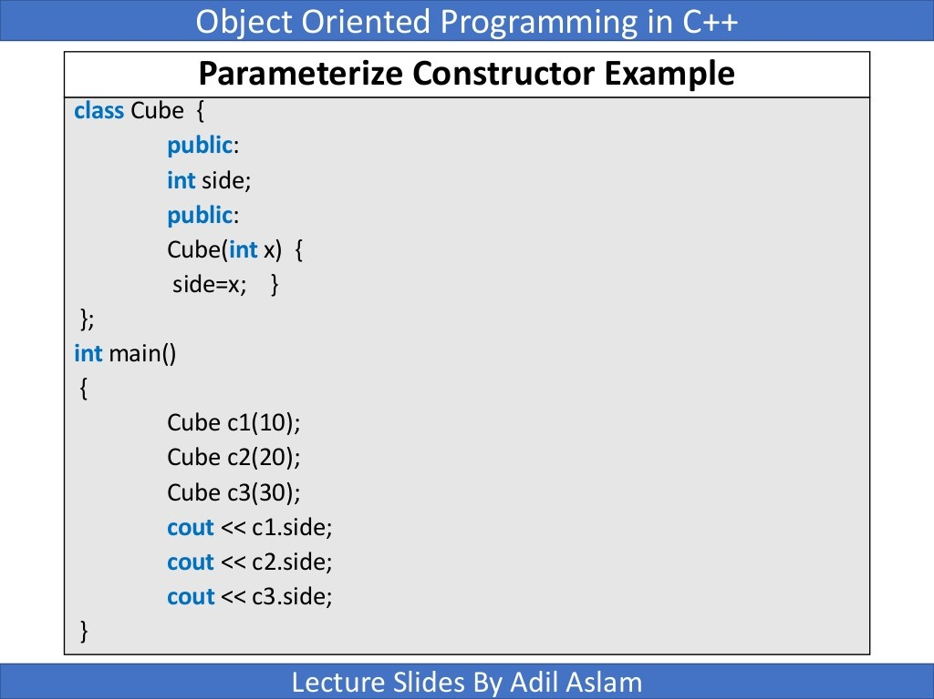

Slide 25
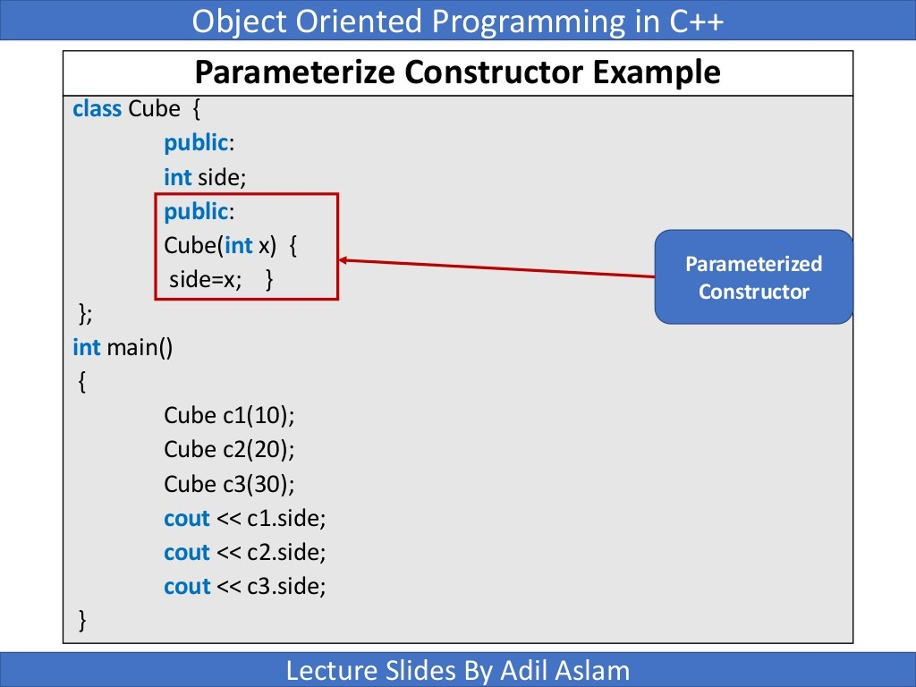

Slide 26
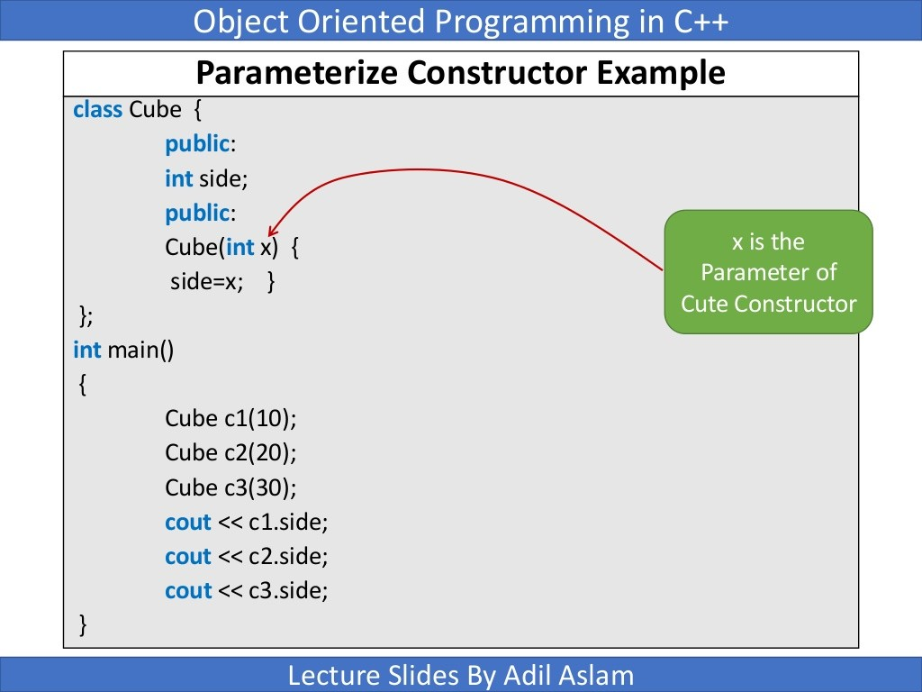

Slide 27
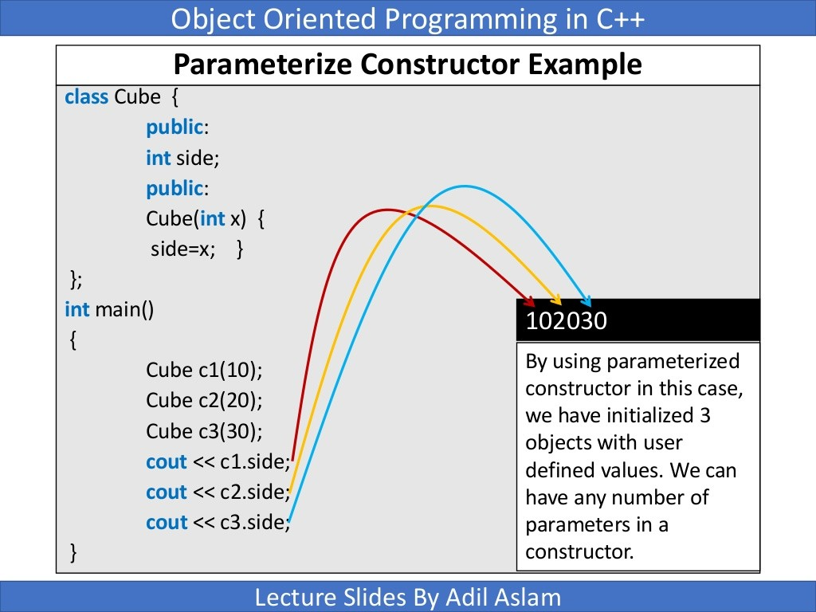

Slide 28
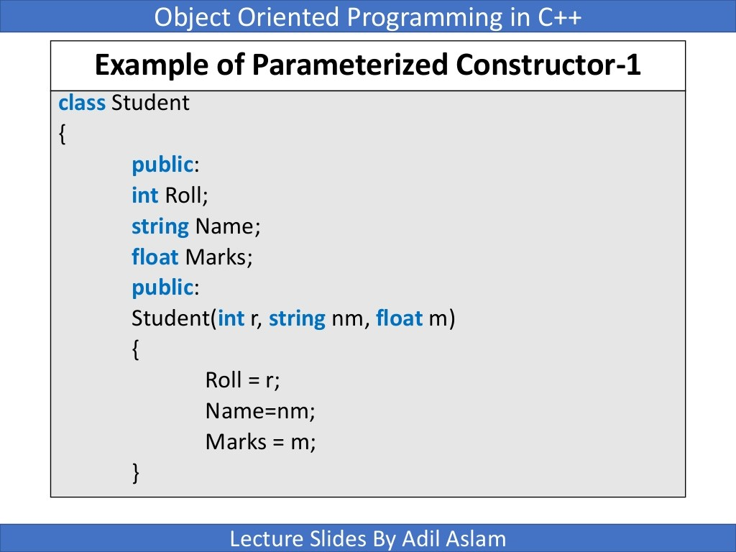

Slide 29
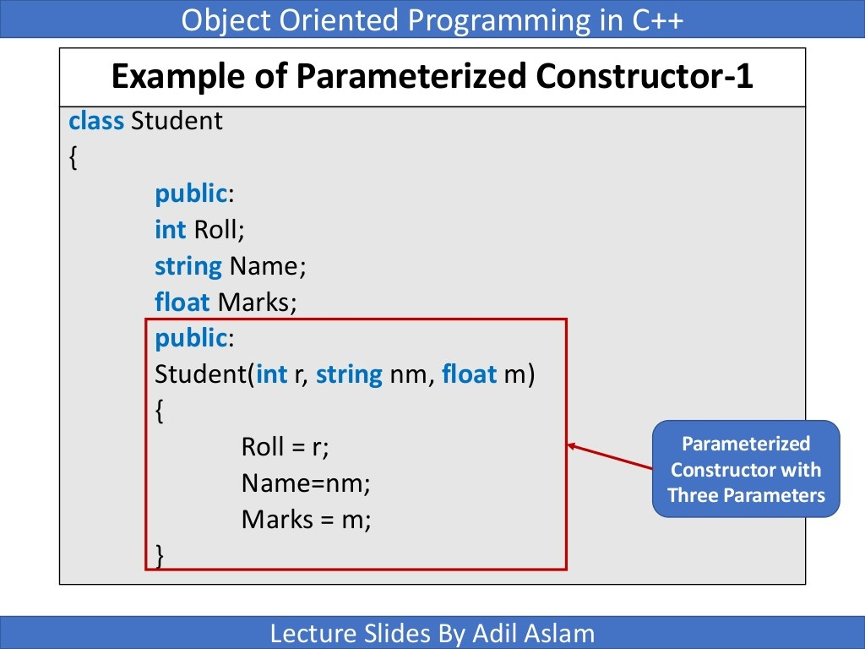

Slide 30
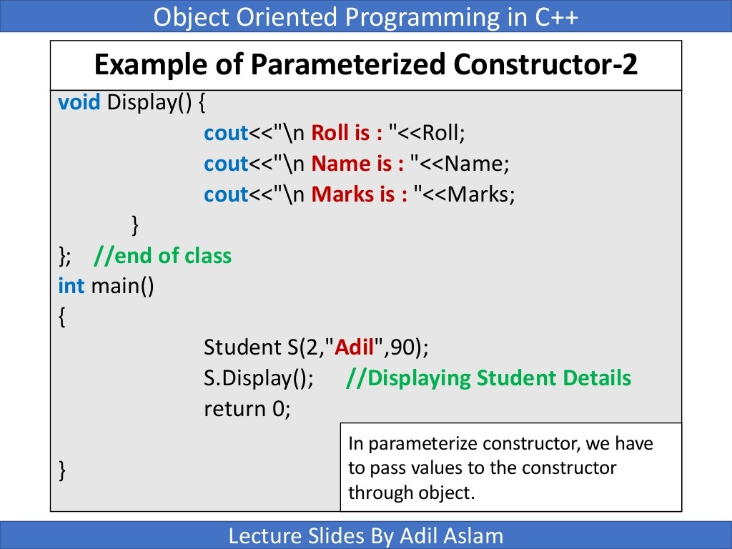

Slide 31
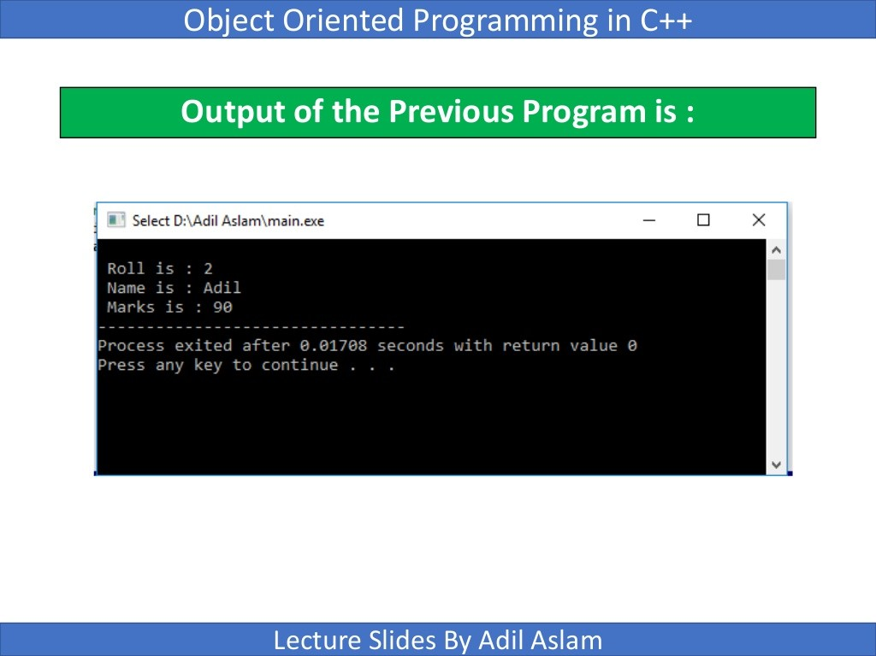

Slide 32
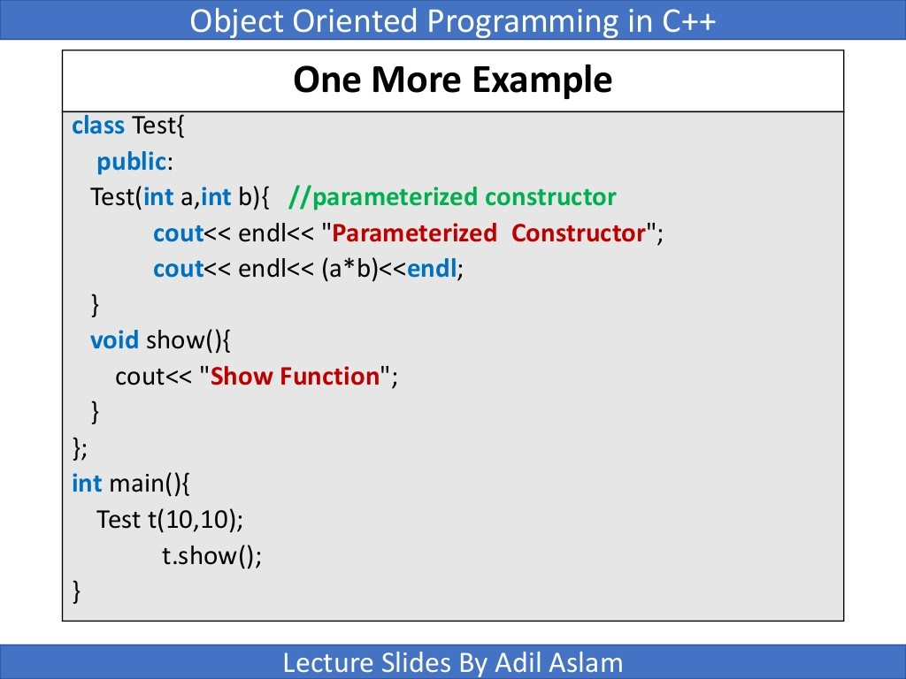

Slide 33
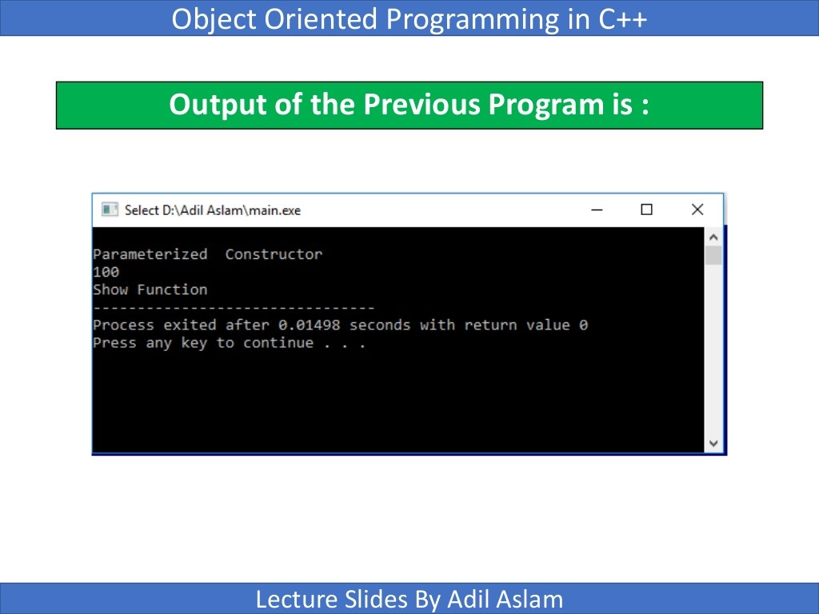

Slide 34

Initializer List
One of the most common tasks a constructor carries out is initializing data members.
In the Counter class the constructor must initialize the count member to 0. You might think that this would be done in the constructor’s function body, like this:
However, this is not the preferred approach (although it does work). Here’s how you should initialize a data member:

Slide 35

Initializer List
The initialization takes place following the member function declarator but before the function
body.
It’s preceded by a colon. The value is placed in parentheses following the member data.
Other example..

Slide 36
Class Activity
Write a class that contains two integer data members which are initialized to 100 when an object is created. It has a member function avg that displays the average of data members.

Slide 37
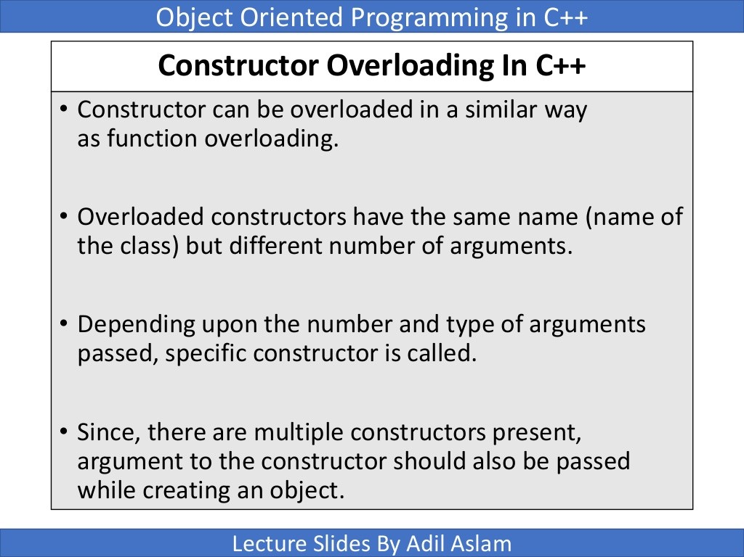

Slide 38
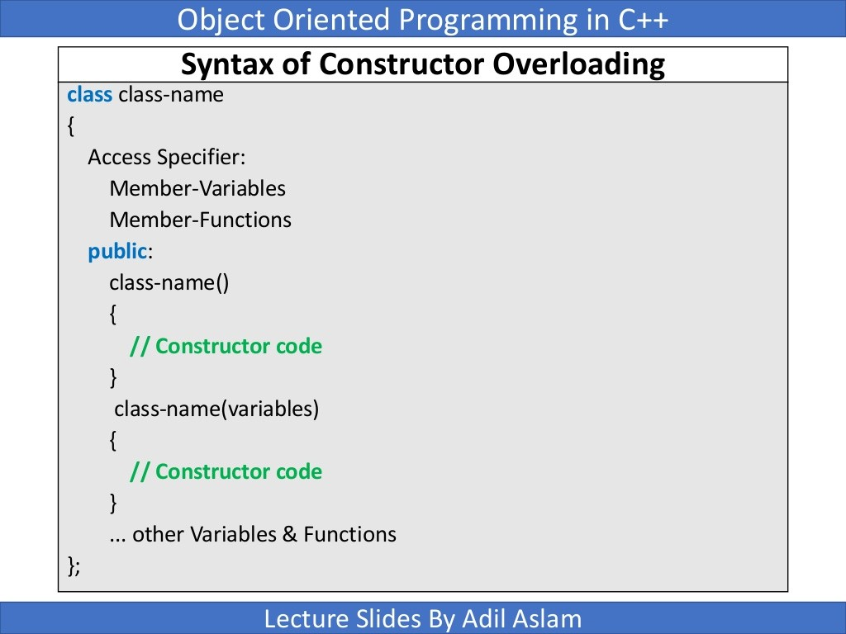

Slide 39
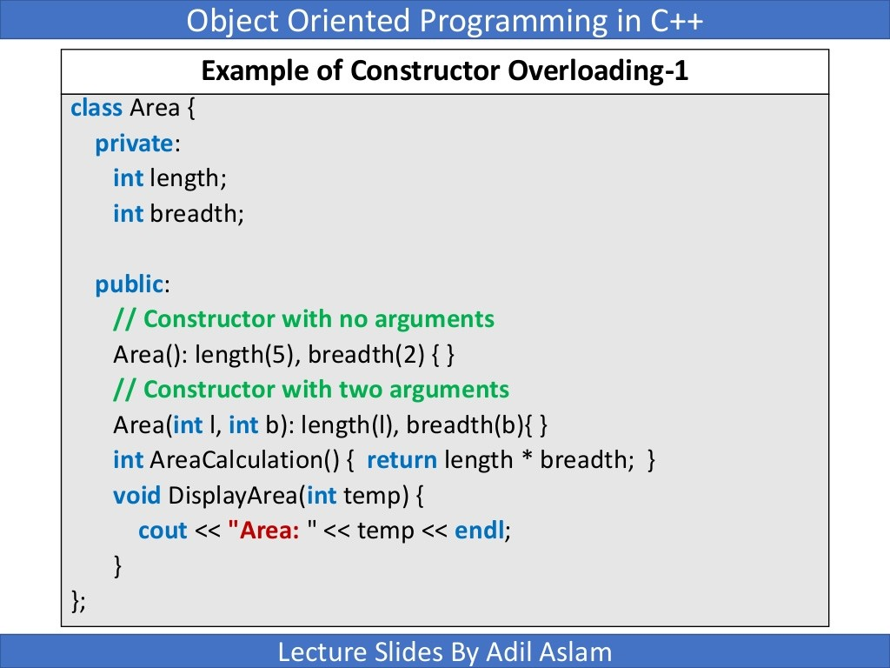

Slide 40
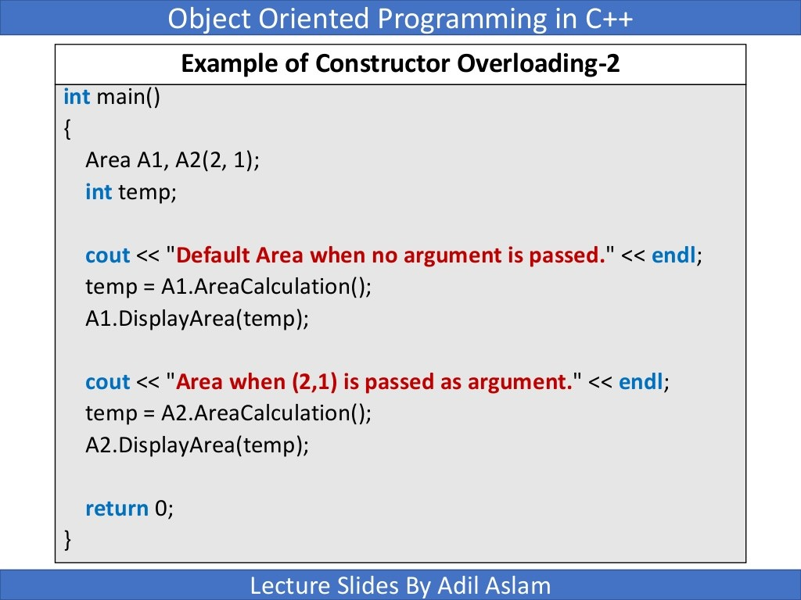

Slide 41
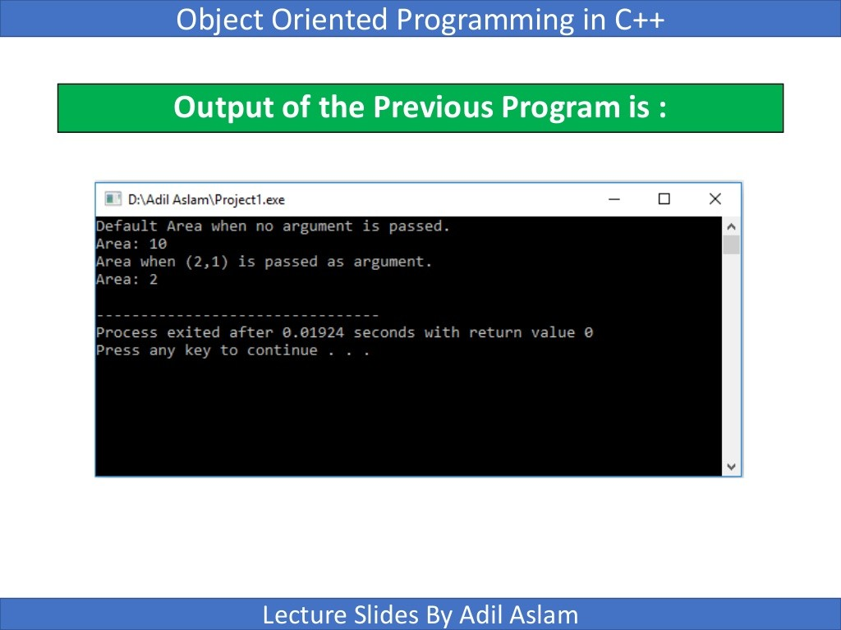

Slide 42
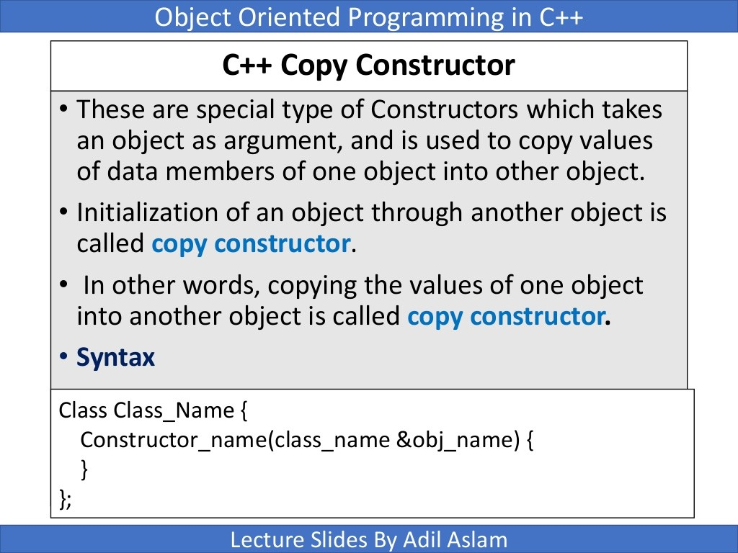

Slide 43
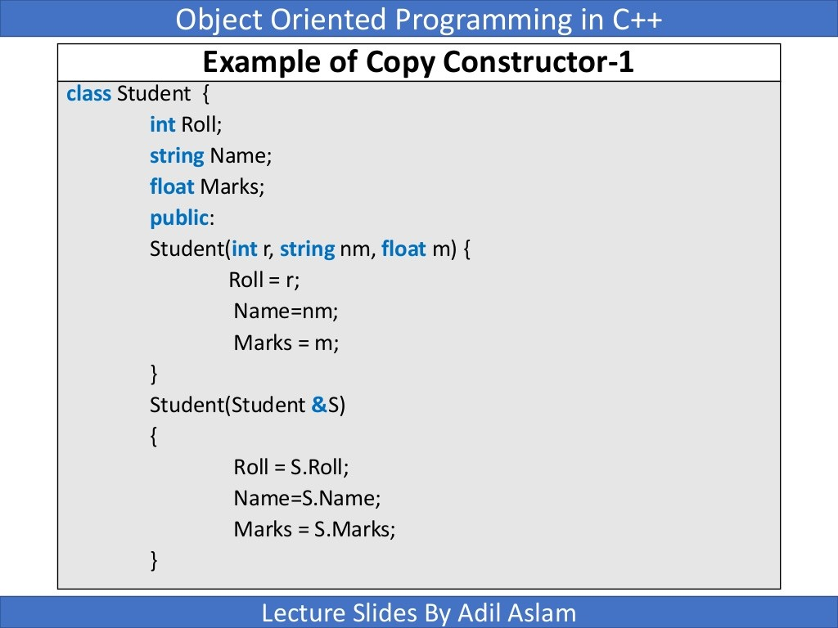

Slide 44
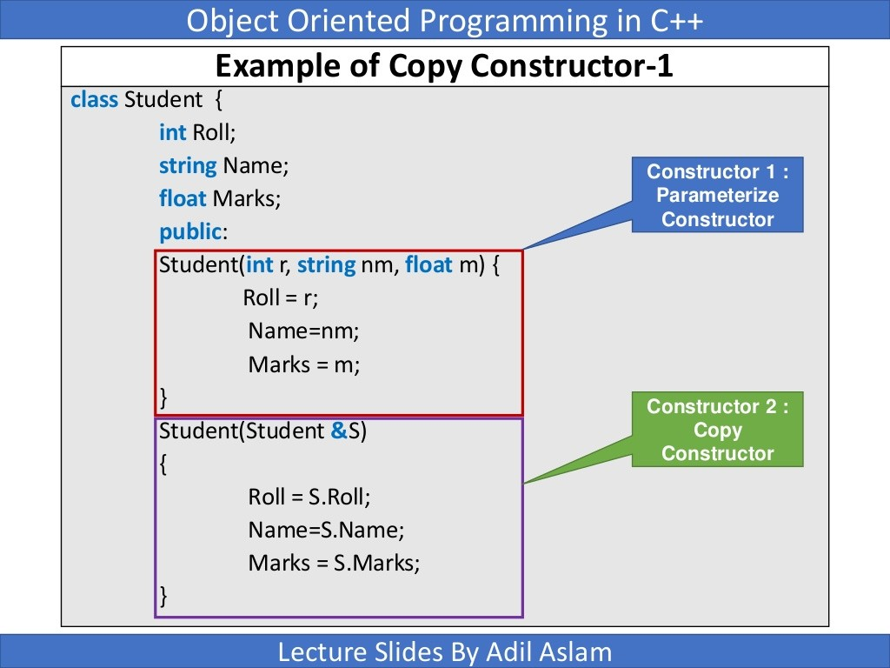

Slide 45
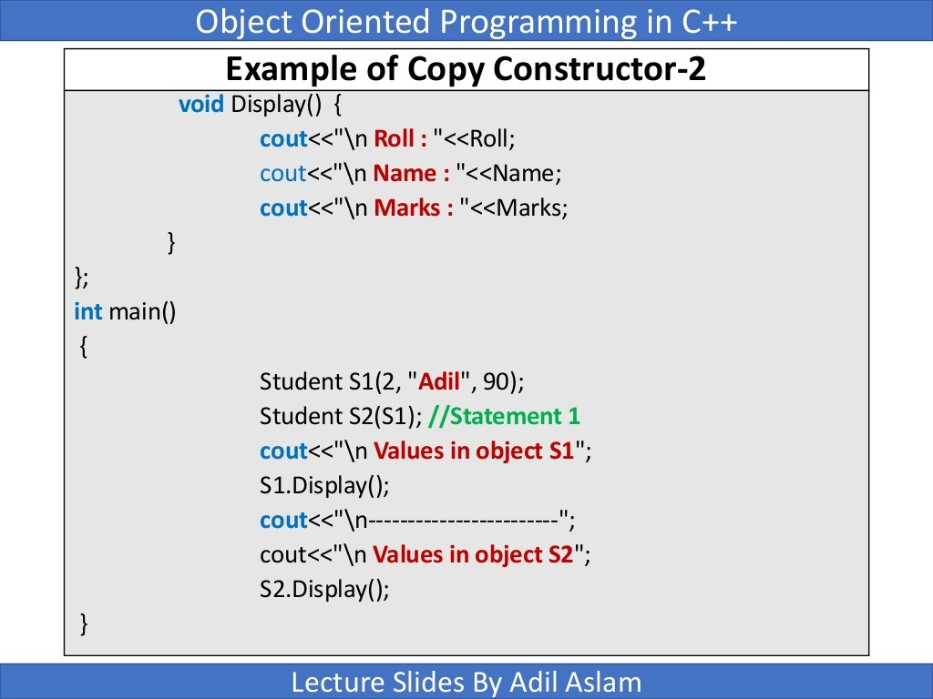

Slide 46
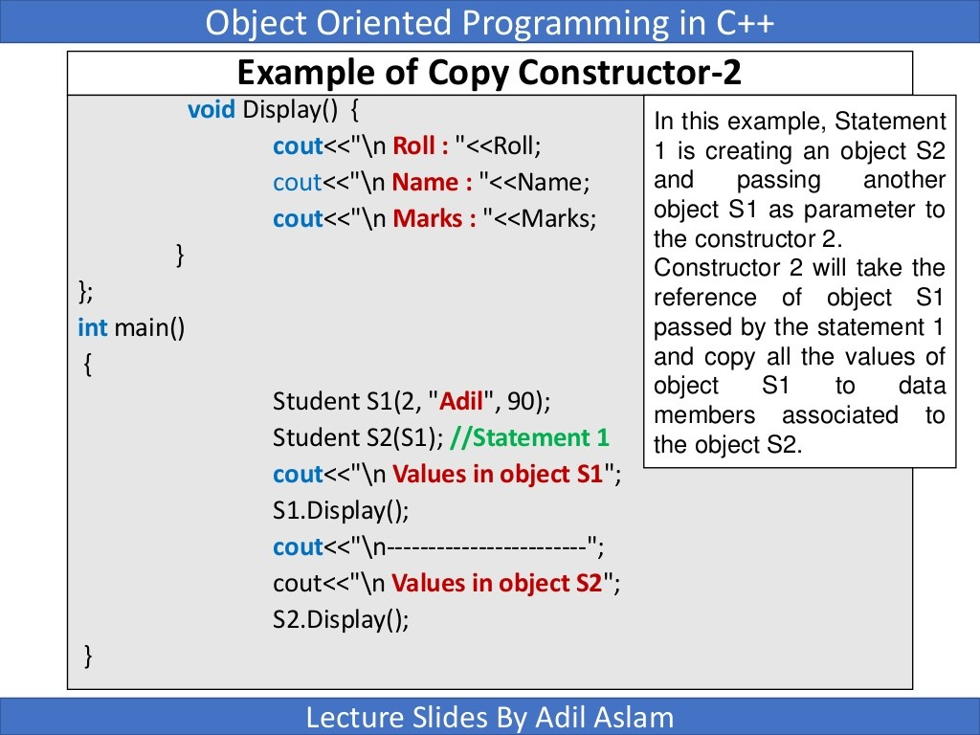

Slide 47
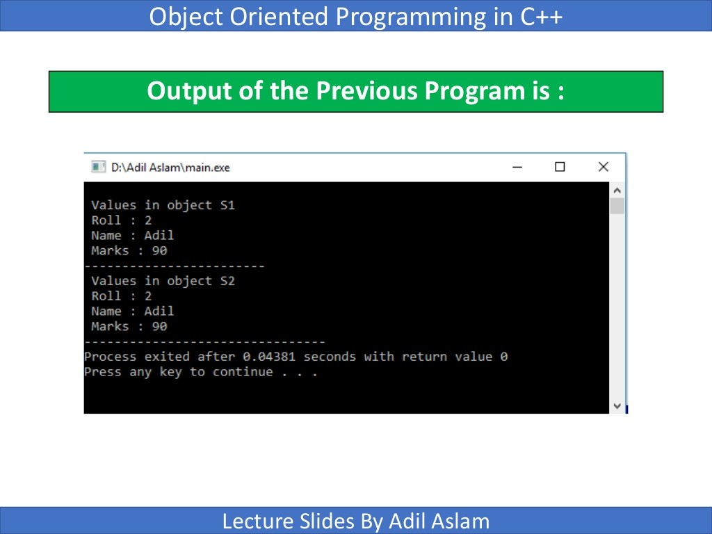

Slide 48
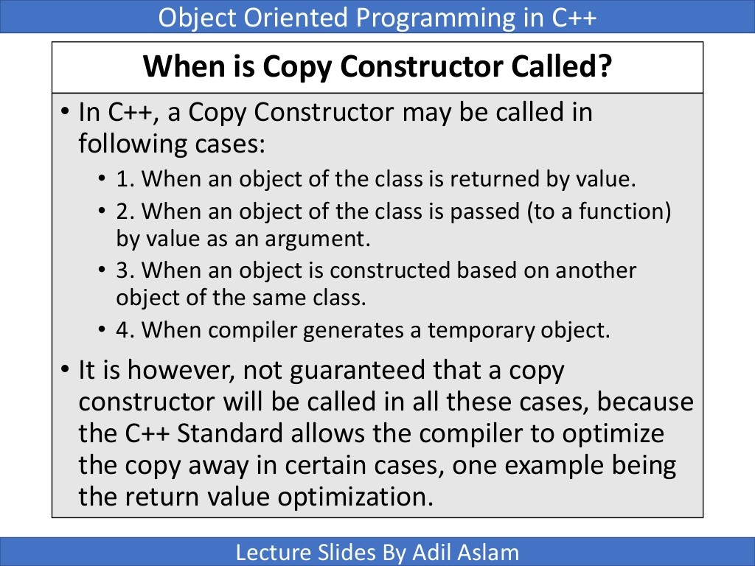

Slide 49
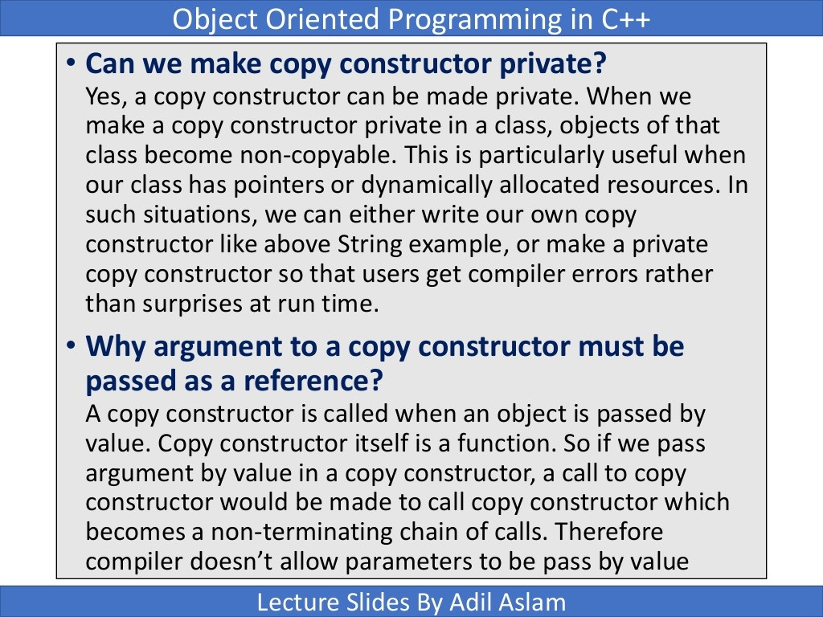

Slide 50
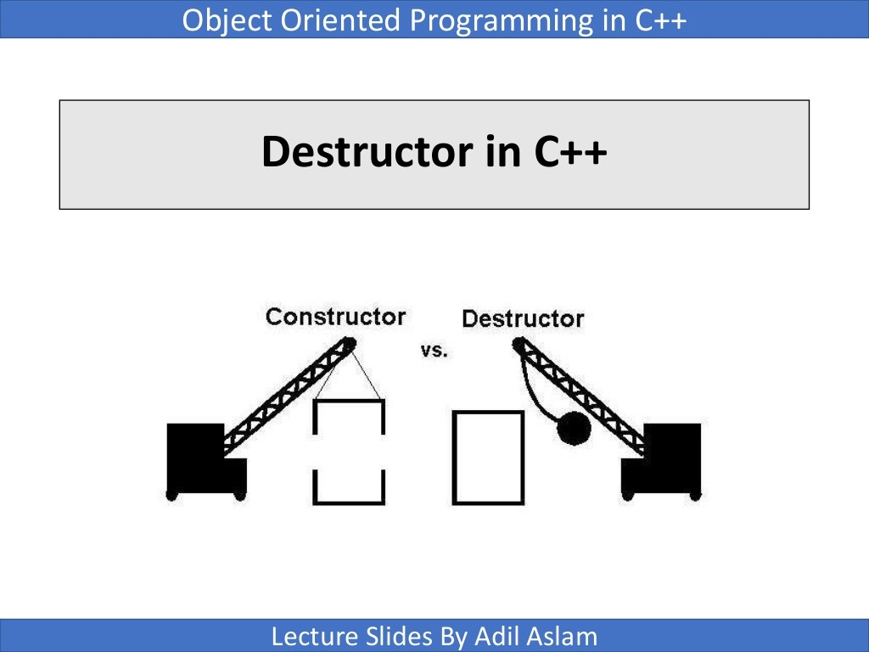

Slide 51
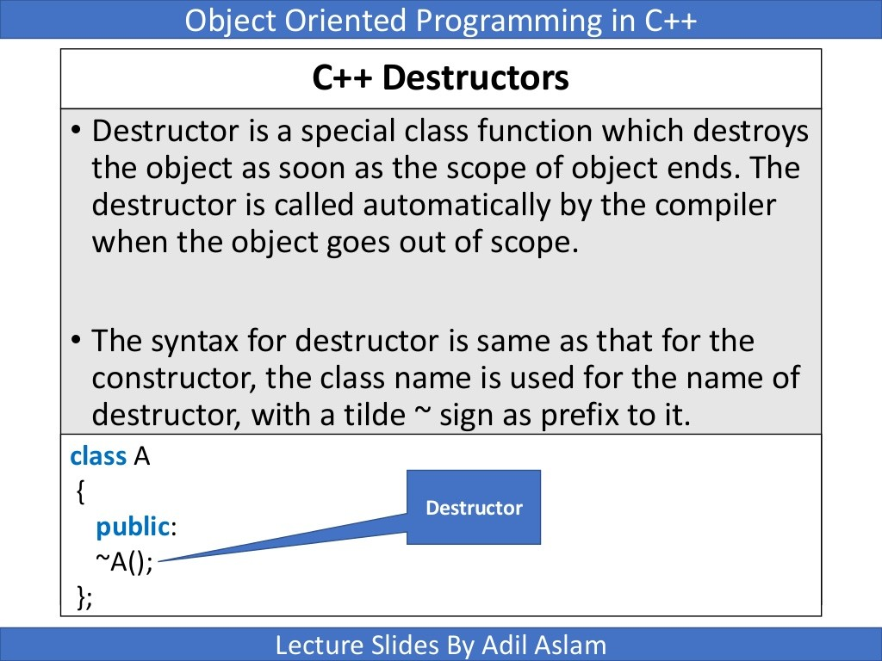

Slide 52
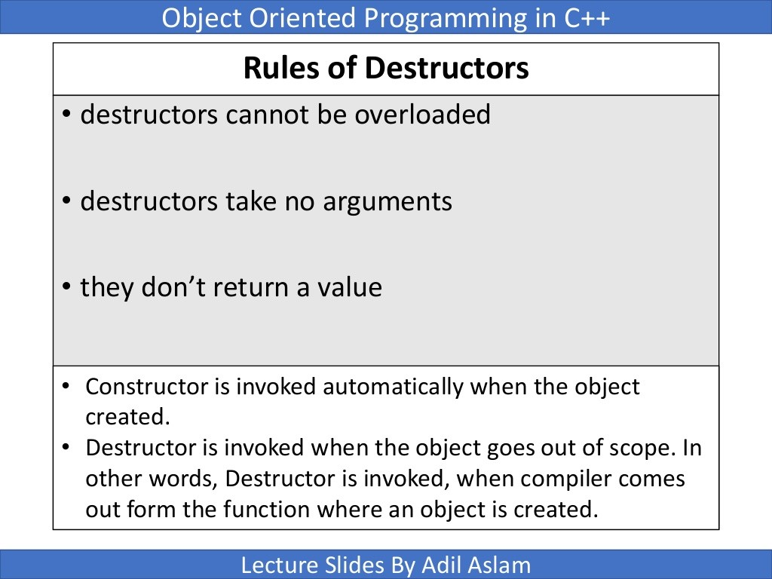

Slide 53
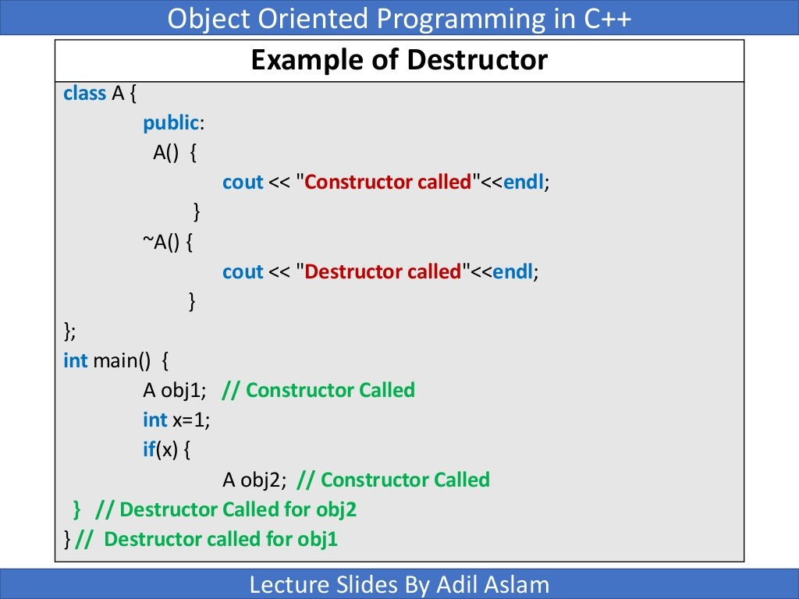

Slide 54
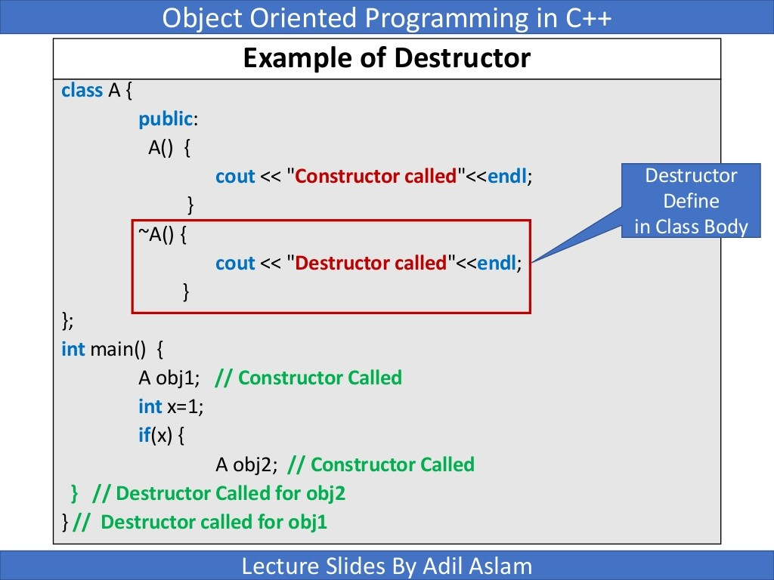

Slide 55
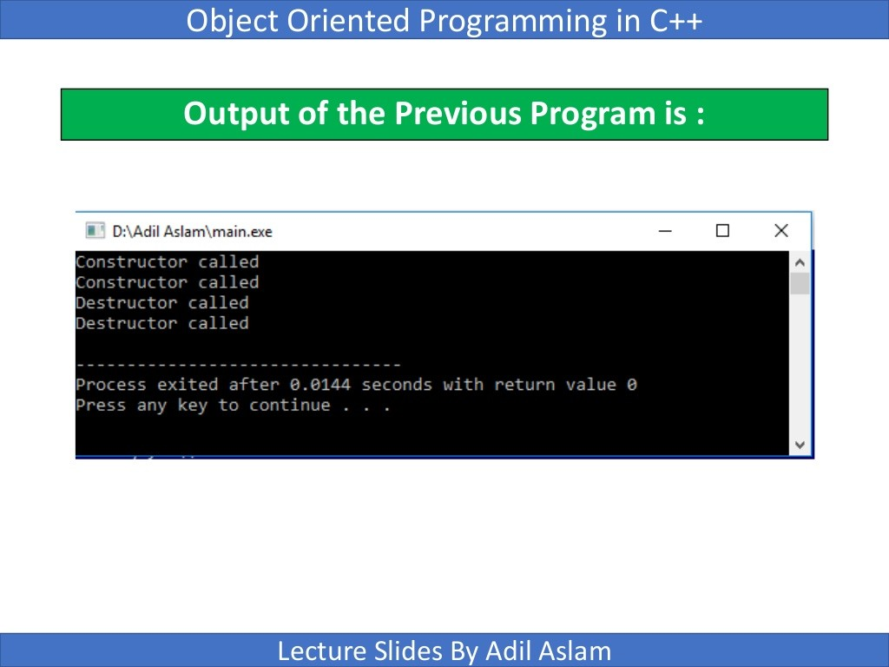

Slide 56
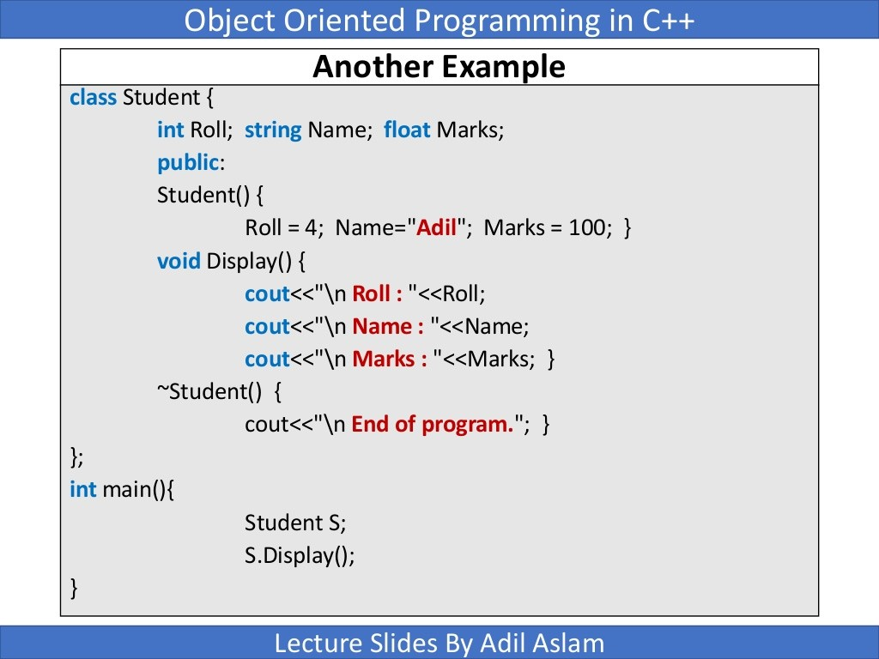

Slide 57


Slide 58


